Slide 1
Homework session 3 – Pairwise Counting GUI
Steven Verwerft
Dept. Engineering management, University of Antwerp
Notes:
This presentation will demonstrate the use of mixed models in the context of validating heuristic performance. We will do this by the hand of two examples that are familiar in the literature. First we will consider the case where different algorithms are compared to one another on one arbitrary point in time. Which is usually defined by some kind of stopping criterion for each of the algorithms in the comparison. The second example is a case where more than one point in time is considered in the analysis, which often results in the comparison of time series.

Slide 2
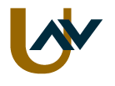
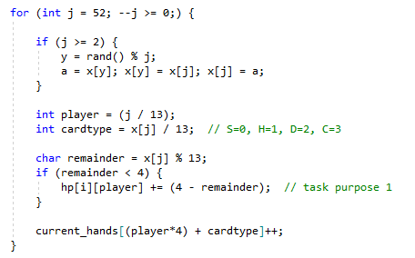
Deal the cards

Slide 3
Card encoding
 | A | K | Q | J | T | 9 | 8 | 7 | 6 | 5 | 4 | 3 | 2
Spades | 0 | 1 | 2 | 3 | 4 | 5 | 6 | 7 | 8 | 9 | 10 | 11 | 12
Hearts | 13 | 14 | 15 | 16 | 17 | 18 | 19 | 20 | 21 | 22 | 23 | 24 | 25
Diamonds | 26 | 27 | 28 | 29 | 30 | 31 | 32 | 33 | 34 | 35 | 36 | 37 | 38
Clubs | 39 | 40 | 41 | 42 | 43 | 44 | 45 | 46 | 47 | 48 | 49 | 50 | 51

Slide 4
Card encoding
code%13
 | A | K | Q | J | T | 9 | 8 | 7 | 6 | 5 | 4 | 3 | 2
Spades | 0 | 1 | 2 | 3 | 4 | 5 | 6 | 7 | 8 | 9 | 10 | 11 | 12
Hearts | 0 | 1 | 2 | 3 | 4 | 5 | 6 | 7 | 8 | 9 | 10 | 11 | 12
Diamonds | 0 | 1 | 2 | 3 | 4 | 5 | 6 | 7 | 8 | 9 | 10 | 11 | 12
Clubs | 0 | 1 | 2 | 3 | 4 | 5 | 6 | 7 | 8 | 9 | 10 | 11 | 12

Slide 5
Card encoding
Max((4 – code%13), 0)
 | A | K | Q | J | T | 9 | 8 | 7 | 6 | 5 | 4 | 3 | 2
Spades | 0 | 1 | 2 | 3 | 4 | 5 | 6 | 7 | 8 | 9 | 10 | 11 | 12
Hearts | 13 | 14 | 15 | 16 | 17 | 18 | 19 | 20 | 21 | 22 | 23 | 24 | 25
Diamonds | 26 | 27 | 28 | 29 | 30 | 31 | 32 | 33 | 34 | 35 | 36 | 37 | 38
Clubs | 39 | 40 | 41 | 42 | 43 | 44 | 45 | 46 | 47 | 48 | 49 | 50 | 51
 | A | K | Q | J | T | 9 | 8 | 7 | 6 | 5 | 4 | 3 | 2
Spades | 0 | 1 | 2 | 3 | 4 | 5 | 6 | 7 | 8 | 9 | 10 | 11 | 12
Hearts | 0 | 1 | 2 | 3 | 4 | 5 | 6 | 7 | 8 | 9 | 10 | 11 | 12
Diamonds | 0 | 1 | 2 | 3 | 4 | 5 | 6 | 7 | 8 | 9 | 10 | 11 | 12
Clubs | 0 | 1 | 2 | 3 | 4 | 5 | 6 | 7 | 8 | 9 | 10 | 11 | 12
 | A | K | Q | J | T | 9 | 8 | 7 | 6 | 5 | 4 | 3 | 2
Spades | 4 | 3 | 2 | 1 | 0 | 0 | 0 | 0 | 0 | 0 | 0 | 0 | 0
Hearts | 4 | 3 | 2 | 1 | 0 | 0 | 0 | 0 | 0 | 0 | 0 | 0 | 0
Diamonds | 4 | 3 | 2 | 1 | 0 | 0 | 0 | 0 | 0 | 0 | 0 | 0 | 0
Clubs | 4 | 3 | 2 | 1 | 0 | 0 | 0 | 0 | 0 | 0 | 0 | 0 | 0

Slide 6
After each deal i
Array current_hands:
card
S | H | D | C
5 | 2 | 4 | 2
0 | 1 | 2 | 3
S | H | D | C
2 | 6 | 2 | 3
4 | 5 | 6 | 7
S | H | D | C
4 | 4 | 3 | 2
8 | 9 | 10 | 11
S | H | D | C
2 | 1 | 4 | 6
12 | 13 | 14 | 15
amount
index
Player 0
Player 1
Player 2
Player 3

Slide 7
After each deal i
Sorted(current_hands) => distributions
Value = (((I – 4) * 7) + j) * 5 + k
5 | 4 | 2 | 2
0 | 1 | 2 | 3
6 | 3 | 2 | 2
4 | 5 | 6 | 7
4 | 4 | 3 | 2
8 | 9 | 10 | 11
6 | 4 | 2 | 1
12 | 13 | 14 | 15
amount
index
Player 0
Value 57
Player 1
Value 87
Player 2
Value 23
Player 3
Value 92

Slide 8
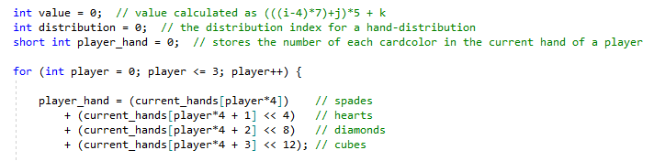
Coding the player’s hand

Slide 9
Coding the player’s hand
Transform player hand to short-int:
card
S | H | D | C
5 | 2 | 4 | 2
0 | 1 | 2 | 3
card
15 | 14 | 13 | 12
0 | 0 | 1 | 0
11 | 10 | 9 | 8
0 | 1 | 0 | 0
7 | 6 | 5 | 4
0 | 0 | 1 | 0
3 | 2 | 1 | 0
0 | 1 | 0 | 1
amount
amount
coding
Cubes = 2
Diamonds = 4
Hearts = 2
Spades = 5
Player 0

Slide 10
Coding the player’s hand
Get number of hearts (code = 1)
card
S | H | D | C
5 | 2 | 4 | 2
0 | 1 | 2 | 3
amount
Hearts = 2
coding
15 | 14 | 13 | 12
0 | 0 | 1 | 0
0 | 0 | 0 | 0
0 | 0 | 0 | 0
0 | 0 | 0 | 0
11 | 10 | 9 | 8
0 | 1 | 0 | 0
0 | 0 | 1 | 0
0 | 0 | 0 | 0
0 | 0 | 0 | 0
7 | 6 | 5 | 4
0 | 0 | 1 | 0
0 | 1 | 0 | 0
0 | 0 | 0 | 0
0 | 0 | 0 | 0
3 | 2 | 1 | 0
0 | 1 | 0 | 1
0 | 0 | 1 | 0
1 | 1 | 1 | 1
0 | 0 | 1 | 0
Player 0
>> code * 4
&15
= 2

Slide 11
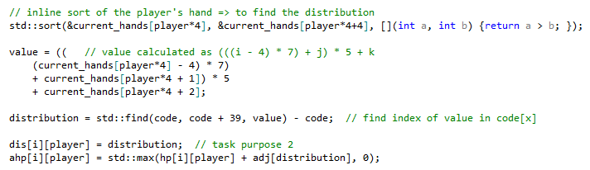
Get the distribution
(looping over each player (0, 1, 2, 3)

Slide 12
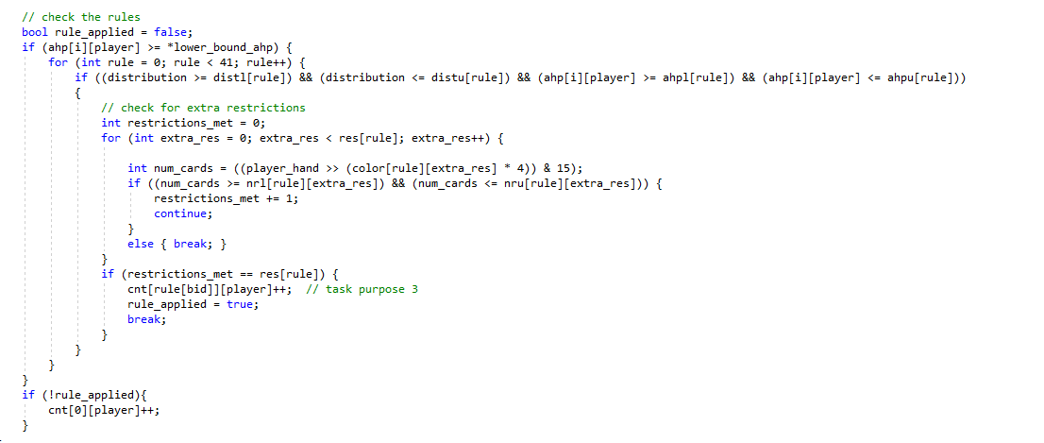
Check the rules

